Slide 1

B.Tech Project Evaluation-1
SMART IOT BASED PARKING SYSTEM
Presented by :-
SUNNY RANA
SHAHID IMRAN
SHUBHAM MATHUR
Under the Supervision of:-
(GUNJAN AGGARWAL)
Assistant Professor
Sharda University, Gr. Noida
DEPARTMENT OF COMPUTER SCIENCE & ENGINEERING
SCHOOL OF ENGINEERING AND TECHNOLOGY
Feb 2022
1

Slide 2
PROJECT OVERVIEW SMART PARKING SYSTEM
There has been a tremendous growth in the number of vehicles on road in past few years. But unfortunately the road networks and road widths have not grown in proportion to vehicle numbers. This has created in huge parking crisis especially in urban areas. At such times smart online parking systems are the need of the hour. This system aims at replacing the conventional parking system with an IoT-based smart parking system by using RFID (radio-frequency identification). The users will be provided an entry card for getting access to the parking slot. The users will also be provided with an android based mobile application, using which they can know about the availability of the parking slot on their mobile phones. Along with getting to know the real time availability of the parking slots the system also has the concept of detecting wrongly parked car within the parking area. In a parking area there are many areas which are either reserved or strictly no parking. Thus the system here also uses the concepts of RFID to get the car detected. In this way, this smart parking system will help reduce human effort & time by using automation technology.

Slide 3
WORK DISTRIBUTION OF TEAM
SUNNY RANA : DOCUMENTATION , RFID DETECTION
SHAHID IMRAN : DOCUMENTATION , IR SENSOR DETECTION
SHUBHAM MATHUR : DOCUMENTATION , DC MOTOR GATES

Slide 4
IMPROVEMENT/WORK DONE FROM LAST EVALUATION
RESEARCH PAPER HAS BEEN ACCEPTED (BOTH 7TH AND 8TH )
PROJECT HAS BEEN DEVELOPED

Slide 5
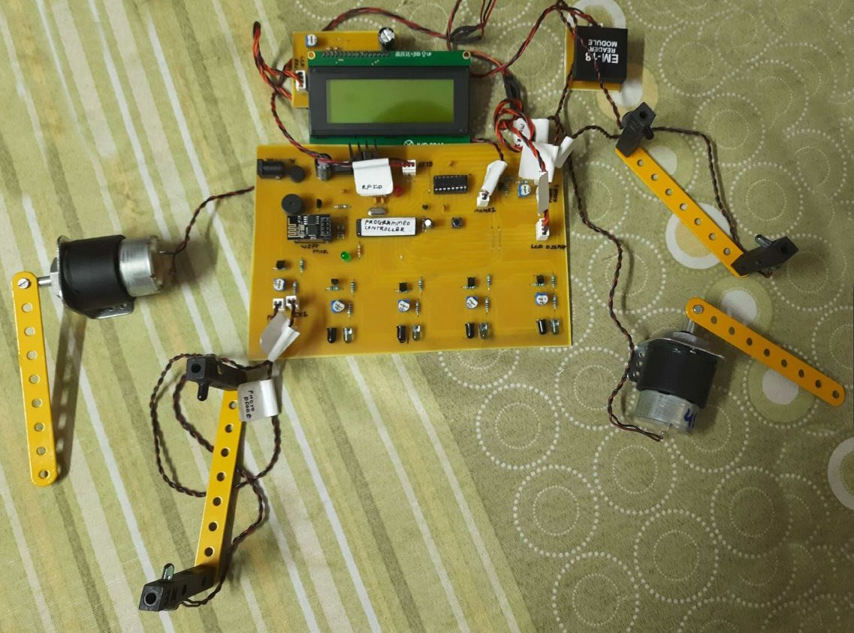
PROJECT SETUP FOR SMART PARKING SYSTEM

Slide 6
MATERIAL REQUIRED
Atmega Microcontroller
DC Motor
LCD Display
RFID Sanner
Wifi Module
IR Sensors
Resistors
Capacitors
Buttons & Switches
Electrical & Wirings
PCB Board
Diodes Transistors
Connectors

Slide 7
APPLICATIONS OF THE SYSTEM
Residential Parking
Public Parking Spaces
Airport/Railway Parking
Mall Parking

Slide 8
ADVANTAGES OF THE SYSTEM
Automatic Parking System with Zero Human Intervention
RFID Scan for Access Verification
Automatic Gate Barriers for Entry Exit
Parking Slot Sensors for Empty Slot Detection
Online Parking Slot availability on Phone
Easy to Use System

Slide 9
Work Done in 7th Sem
DETECTION OF UNAUTHORIZED PARKING USING RFID
Now days in many public places such as supermarkets, offices, hospital area, market areas there is a significant problem of unapproved car parking. This creates a problem on the road for the people and as well as for the authority to trace the car owner and to clear the obstruction. So, there is a need of developing an labour saving system that indicates directly the location and the details of a car parked in an unauthorised parking area. This system includes an RFID transmitter that is attached in every bus, cab, jeep, and other vehicles[3]. RFID receiver circuits are mounted in every area where parking is prohibited. If a car parks in an unauthorized area the RFID detector detects the car and sends the notification to the driver regarding the wrongly parked car and also about the fine being imposed on the driver for the offence. The pros of this system is that less human intervention is required and any attempts to bribe or to evade the fine for the offence are nearly nullified.
9
Notes:
9

Slide 10
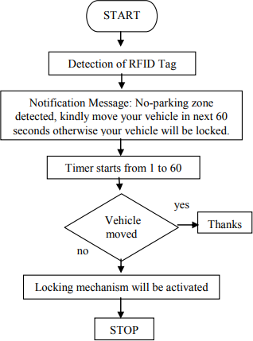
FLOW DIAGRAM OF THE SYSTEM
If the car is parked in a no parking zone, the RFID receiver detects the car and a message is sent to the driver about wrong parking
No fine is imposed
A message that the driver has been fined is sent to the driver

Slide 11
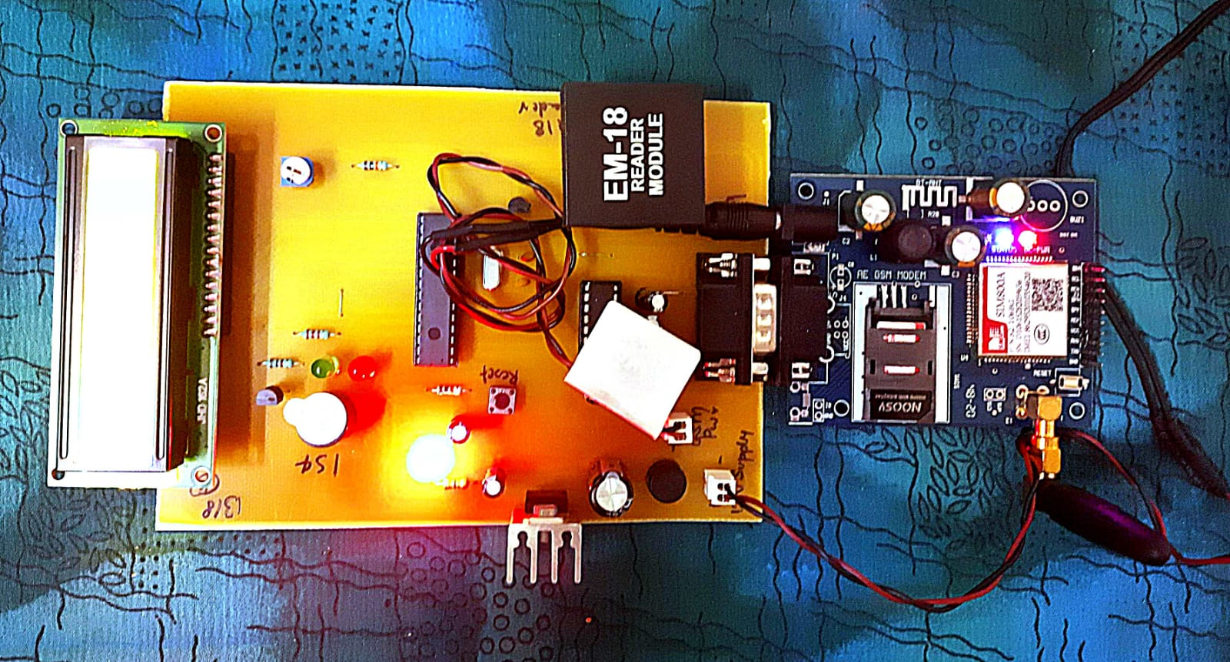
RESULT

Slide 12
